Slide 1


15Cs565
C
Cloud Computing
Cloud Computing

Slide 2
MODULE - 1

Slide 3
Contents
Course Handout Discussion
Introduction
Evolution of cloud computing
Computing Platforms and Technologies
Cloud Computing Architecture
IaaS, PaaS, SaaS,
Types of Clouds
Cloud Computing Environments.

Slide 4
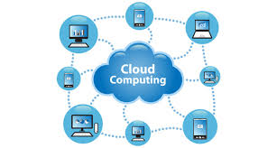
Cloud computing

Slide 5
Basic services
Water
Electricity
Telephony

Slide 6
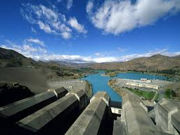
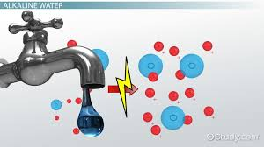
1) Water
Provider
User

Slide 7

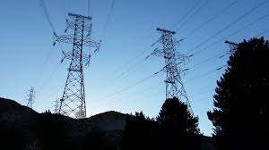
2) Electricity
Provider
User

Slide 8
Computing
Computing is being transformed into a model consisting of services that are commoditized and delivered in a manner similar to utilities such as water, electricity, gas, and telephony.

Slide 9
Cloud computing - turn the vision of “computing utilities "in to a reality.
computer utilities’
- like electric and telephone utilities
- will service individual homes and offices across the country

Slide 10
Example of cloud computation
Users (consumers) need to pay providers only when they access the computing services.
consumers
- no longer need to invest heavily
- encounter difficulties in building and maintaining complex IT infrastructure.

Slide 11
Cloud Computing
Users access services based on their requirements without regard to where the services are hosted.
This model has been referred to as utility computing or, (since 2007), as cloud computing.

Slide 12
Cloud computing
Cloud computing allows
- renting infrastructure,
- runtime environments-IDE
- and services on a pay- per-use basis.
This principle provides-several practical applications and then gives different images of cloud computing to different people.

Slide 13
Cloud computing
One of the most diffuse views of cloud computing can be summarized as follows:
I don’t care where my servers are, who manages them, where my documents are stored, or where my applications are hosted.
I just want them always available and access them from any device connected through Internet.
And I am willing to pay for this service for as a long as I need it.
The concept expressed above has strong similarities to the way we use other services, such as water and electricity.

Slide 14
cloud computing
cloud computing turns IT services into utilities.
a delivery model is made possible by the effective composition of several technologies
Web 2.0 technologies plays a central role in making cloud computing an attractive opportunity for building computing systems.

Slide 15
Service orientation allows cloud computing
- to deliver its capabilities with familiar abstractions.
virtualization allows cloud computing
- provides the necessary degree of customization, - control, and flexibility for building production and enterprise systems.

Slide 16
Overview
Cloud computing at a glance
Historical Developments

Slide 17
Cloud computing at a glance

Slide 18
Massive transformation – from networks to cloud
Computing services readily available on demand, just as other utility services
Pay providers only when you access the computing services
Consumers no longer need to invest heavily - building and maintaining complex IT infrastructure
Utility computing or, recently (since 2007), as cloud computing

Slide 19
What is cloud computing?
Paradigm for the dynamic provisioning of computing services
supported by state-of-the-art data centers
employing virtualization technologies for consolidation and effective utilization of resources
Cloud computing allows renting infrastructure, runtime environments, and services on a pay-per-use basis

Slide 20
Cloud – one point of view
I don’t care
where my servers are,
who manages them,
where my documents are stored,
where my applications are hosted
I just want them
always available and access them from any device connected through Internet
And I am willing to pay for this service for as a long as I need it

Slide 21
Cloud – Composition of several technologies
Web 2.0 technologies - transformed the Internet into a rich application and service delivery platform
Service orientation - to deliver its capabilities with familiar abstractions
Virtualization - necessary degree of customization, control, and flexibility for building production and enterprise systems

Slide 22
Why is cloud popular?
Extremely flexible environment for building new systems and applications​
Easy to integrate additional capacity or new features into existing systems​
Use of dynamically provisioned IT resources – no need to buy additional infrastructure and software​

Slide 23
Vision of Cloud
Anyone with a credit card can provision virtual hardware, runtime environments, and services
Used as needed, with no up-front commitments
The entire stack of a computing system is transformed into a collection of utilities
composed together to deploy systems in hours and with virtually no maintenance costs

Slide 24
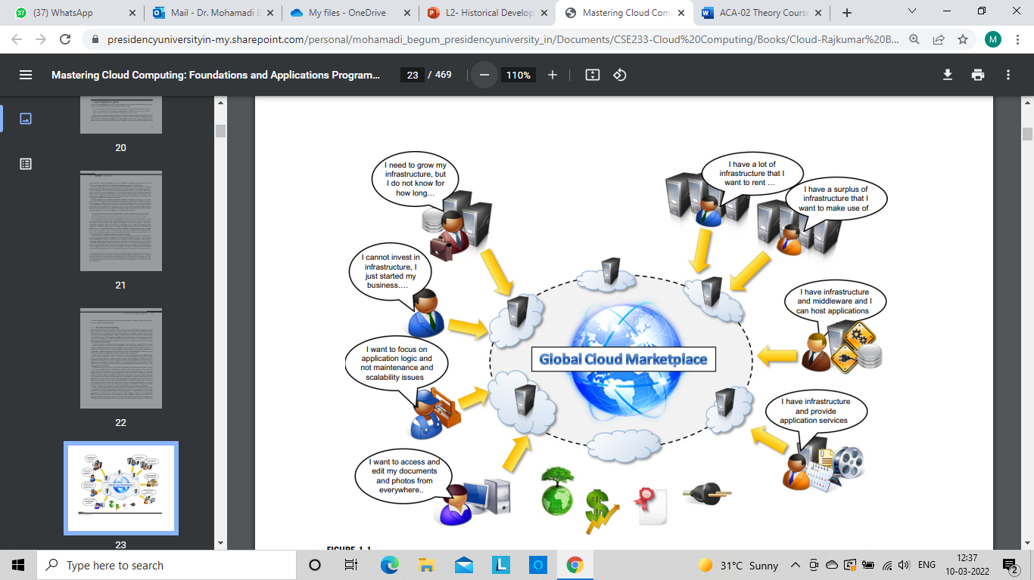
Vision of Cloud

Slide 25
Future – Global cloud marketplace
Give your needs – automation of discovery process and integration of the cloud services
Service providers – increase their revenue
Reduces the barriers between service consumers and providers
Standards
Optimize datacenter facilities – greener computing

Slide 26
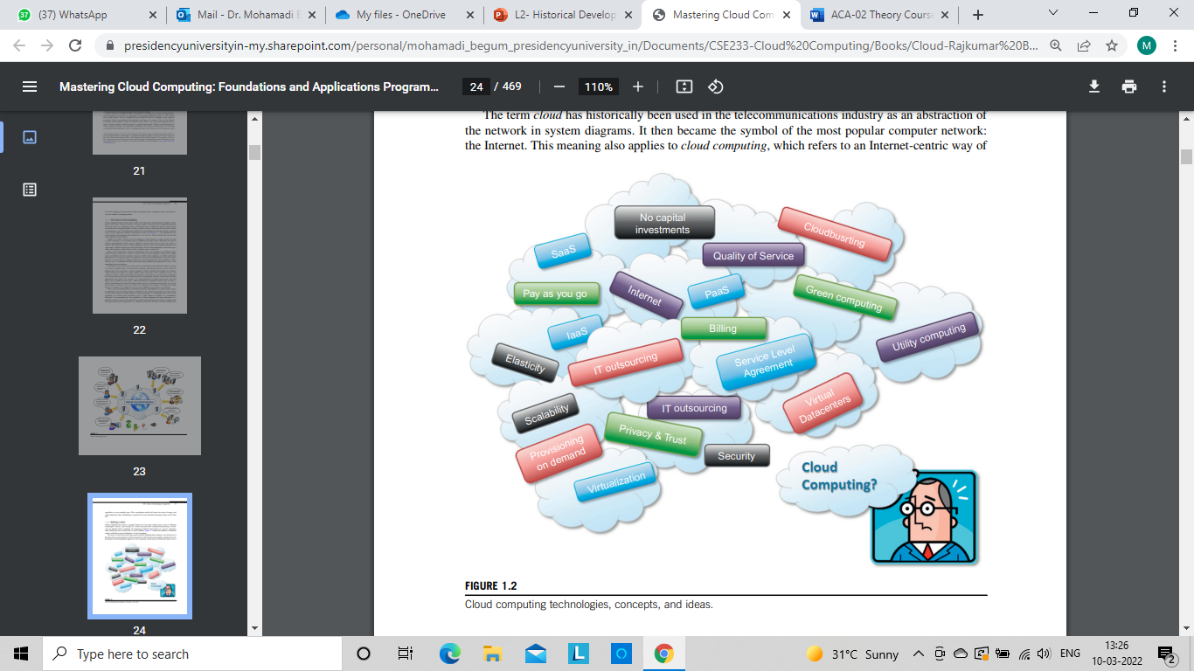
Defining a Cloud

Slide 27
Defining a Cloud
Refers to both the applications delivered as services over the Internet and the hardware and system software in the datacenters that provide those services.
A model for enabling ubiquitous, convenient, on-demand network access to a shared pool of configurable computing resources (e.g., networks, servers, storage, applications, and services) that can be rapidly provisioned and released with minimal management effort or service provider interaction.

Slide 28
Criteria for a cloud service
The service is accessible via a Web browser (nonproprietary) or a Web services application programming interface (API)
Zero capital expenditure is necessary to get started
You pay only for what you use as you use it

Slide 29
Definition (Buyya – utility-oriented)
A cloud is a type of parallel and distributed system
consisting of a collection of interconnected and virtualized computers
that are dynamically provisioned
and presented as one or more unified computing resources
based on service-level agreements
established through negotiation between the service provider and consumers

Slide 30
What do we get from Cloud?
Large enterprises can offload some of their activities
Small enterprises / start-ups translate their ideas into business results more quickly, without excessive up-front costs
System developers can concentrate on the business logic rather than dealing with the complexity of infrastructure management and scalability
End users can have their documents accessible from everywhere and any device
IT Services on Demand

Slide 31
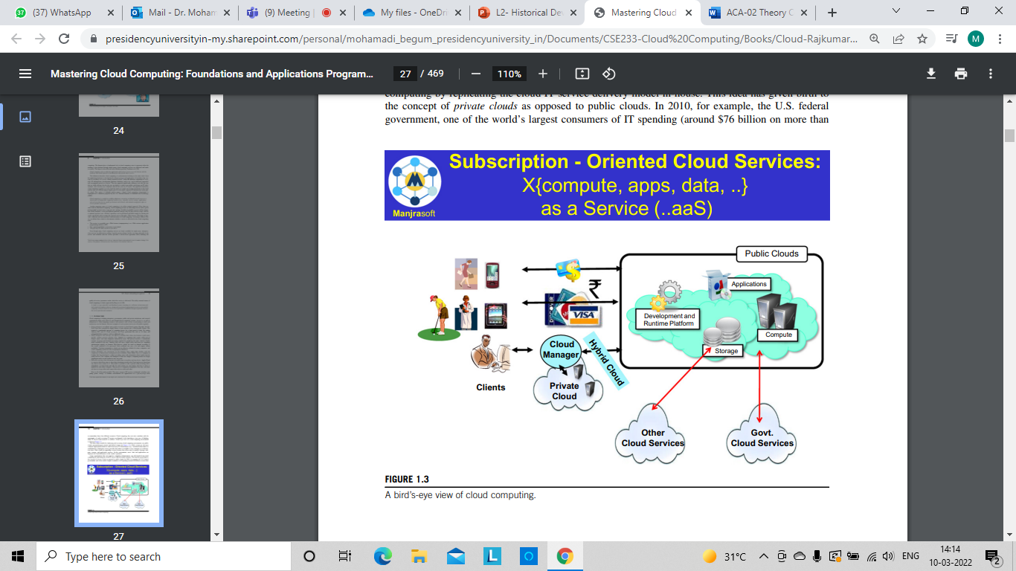
A bird’s-eye view of cloud computing

Slide 32
Historical Developments

Slide 33
5 Core Technologies
Distributed systems
Virtualization
Web 2.0
Service oriented computing
Utility-oriented computing

Slide 34
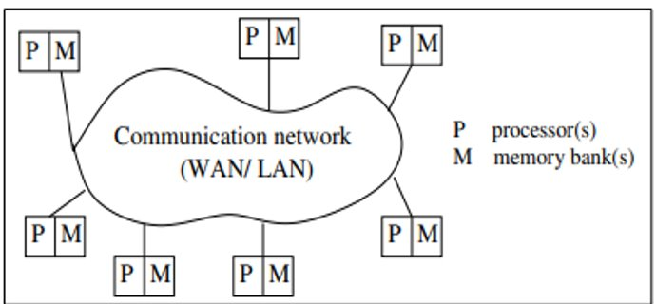
1. Distributed systems
A distributed system is a collection of independent computers that appears to its users as a single coherent system.

Slide 35
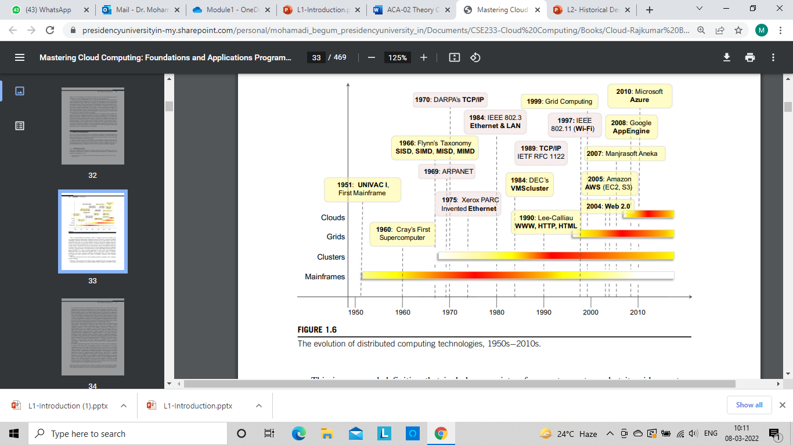
Evolution of Distributed Computing

Slide 36
Major milestones
Mainframe computing
Cluster computing
Grid computing

Slide 37
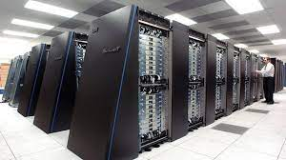
Mainframes
Smaller than a super computer
Large computational facilities leveraging multiple processing units
Powerful, highly reliable computers specialized for large data movement and massive input/output (I/O) operations.
USE:
online transactions
enterprise resource planning
huge data processing

Slide 38
Mainframes – good and bad
Good Scalability
Good memory storage
Highly reliable
Transparent fault tolerance
No interruption while replacing faulty components
Can run multiple OS
High cost
Difficult installation
Huge physical size
Environmental issues

Slide 39
Cluster Computing
Early 1980s
Low-cost alternative to mainframes and supercomputers
Increased availability of cheap commodity machines
Connected by a high-bandwidth network and controlled by specific software tools that manage them as a single system
1980s - clusters - standard technology for parallel and high-performance computing
Could run programs which once required mainframes

Slide 40
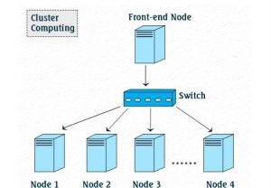
Cluster Computing
Collection of tightly or loosely connected computers (nodes) that work together so that they act as a single entity (transparency)
solve complicated problems
faster computational speed
enhanced data integrity
expandability

Slide 41
Grid Computing
Early 1990s
Analogy to the power grid – consume resources
Aggregate geographically dispersed clusters
By means of Internet connections
These clusters belonged to different organizations
Arrangements were made among them to share the computational power
Different from a “large cluster”
Computing grid - dynamic aggregation of heterogeneous computing nodes, and its scale was nationwide or even worldwide

Slide 42
Why Grid Computing ?
(a) clusters became quite common resources
(b) they were often underutilized
(c) new problems were requiring computational power that went beyond the capability of single clusters
(d) the improvements in networking and the Internet made possible long-distance, high-bandwidth connectivity

Slide 43
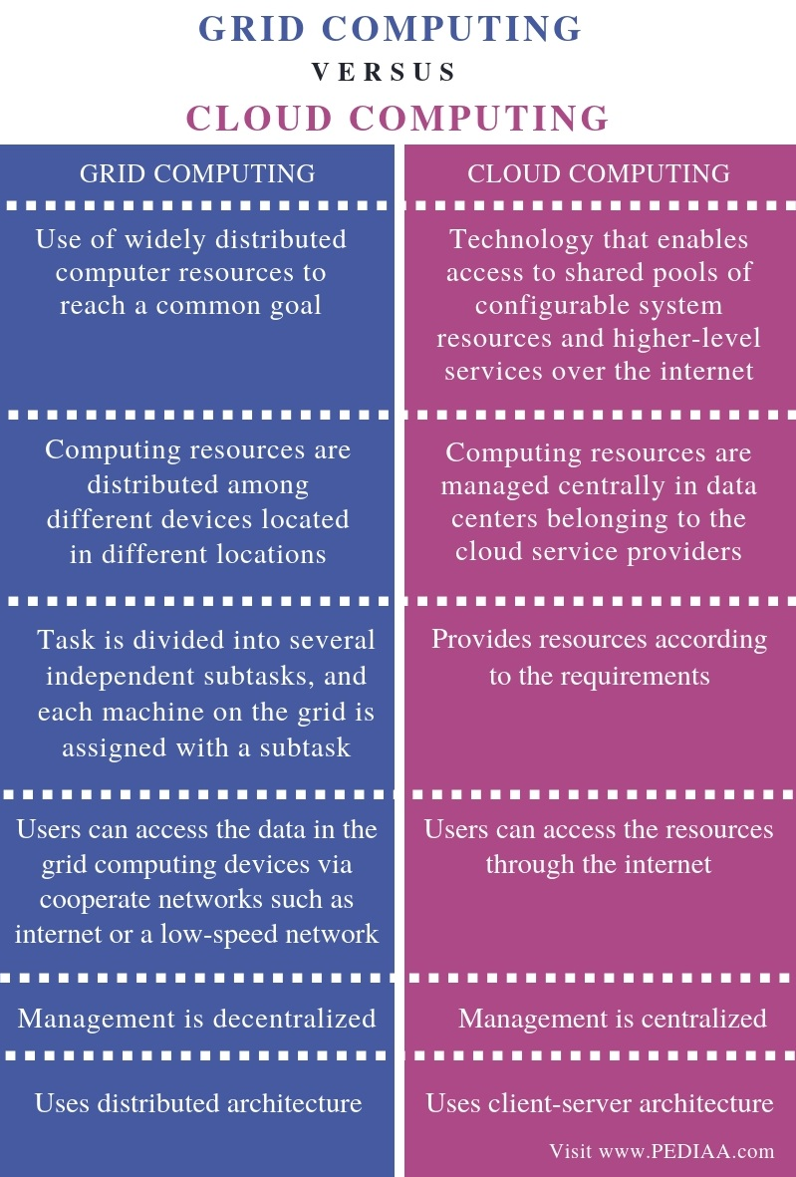

Slide 44
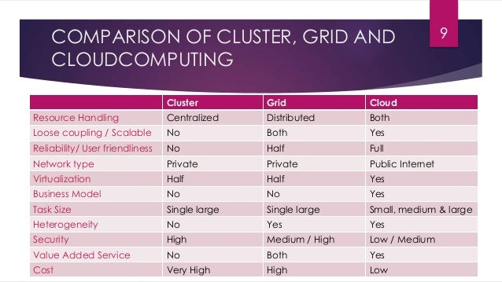

Slide 45
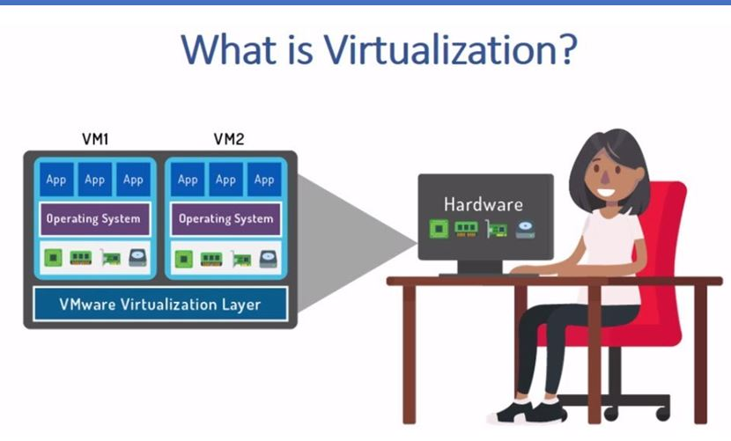
2. Virtualization
Allows creation of different computing environments
These environments are called virtual because they simulate the interface that is expected by a guest
e.g. Hardware virtualization
Enables cloud computing solutions to deliver virtual servers on demand, such as Amazon EC2, RightScale, VMware vCloud

Slide 46
2. Virtualization (Contd.)
Definition
Collection of solutions allowing the abstraction of some of the fundamental elements for computing
Hardware, runtime environments, storage, and networking

Slide 47
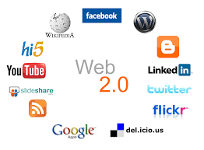
3. Web 2.0
Refers to websites that have user-generated content, ease of use, participatory culture and interoperability for end users
A collection of standards and technologies such as XML, Asynchronous JavaScript and XML (AJAX), Web Services, and others
brings interactivity and flexibility into Web pages
providing enhanced user experience

Slide 48
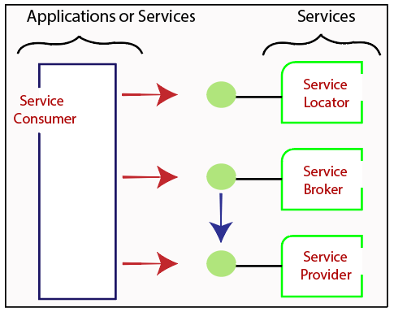
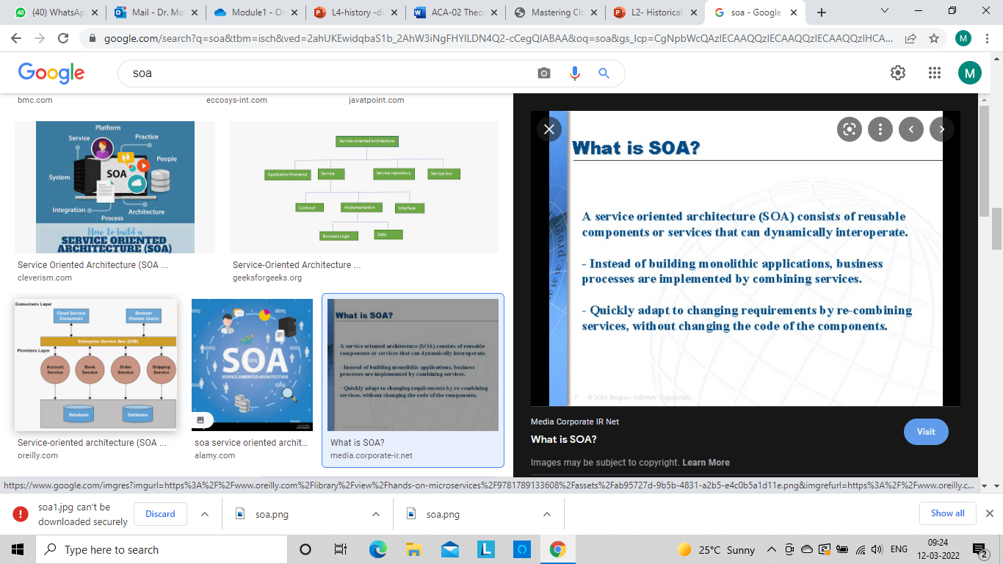
4. Service-oriented computing

Slide 49
5. Utility-oriented computing
is a service provisioning model
providing computing as a utility like natural gas, water, power, and telephone connection
computing resources are provided to the customer based on specific demand
Examples of such IT services are computing power, storage or applications.

Slide 50








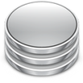





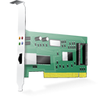
Cloud Computing SERVICE Reference Model
Web 3.0 Interfaces
Software as a Service
End user applications
Scientific applications
Office automation, Photo editing,
CRM, and Social Networking
Examples: Google Documents, Facebook, Flickr, Salesforce
Platform as a Service
Runtime Environment for Applications
Development and Data Processing Platforms
Examples: Windows Azure, Hadoop, Google AppEngine, Aneka
Infrastructure as a Service
Virtualized Servers
Storage and Networking
Examples: Amazon EC2, S3, Rightscale, vCloud
S3: Amazon Simple Storage Service

Slide 51
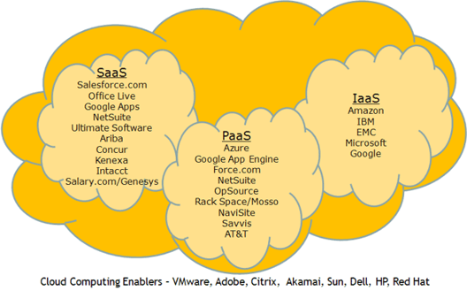
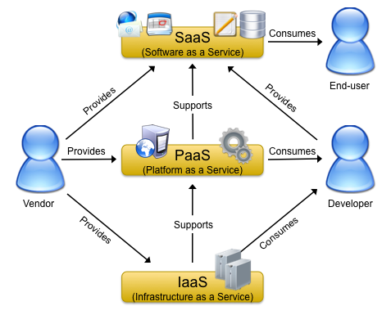
Vendors of SPI Model

Slide 52
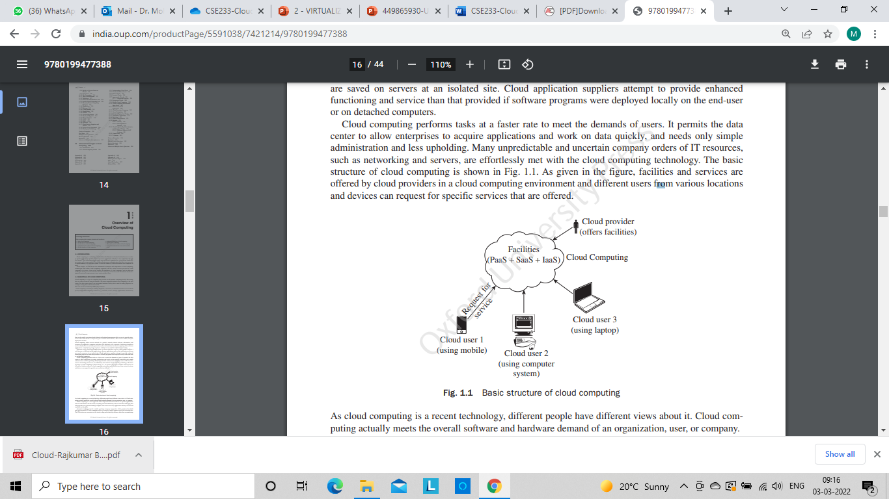
Basic Structure of Cloud Computing

Slide 53
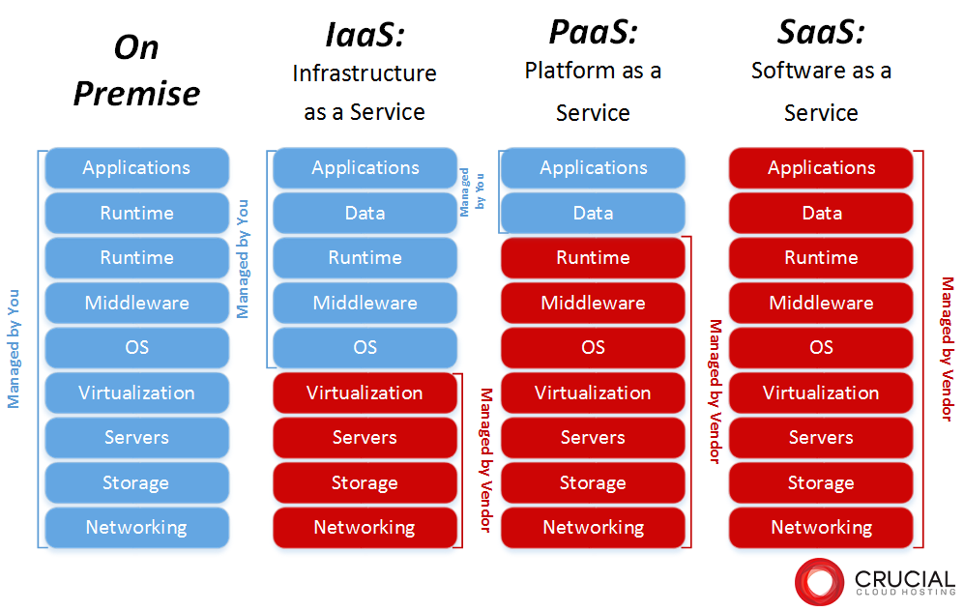

Slide 54
Concept of a “Service” in Cloud Computing
In the Cloud scenario, the provider Organization (Microsoft, Oracle, Amazon, Google) offers the following commodities as services:
Infrastructure (Hardware) -> Storage, Servers, Networking components
Platform to run applications -> Runtimes (JRE, CLR), Operating Systems (Windows, Linux), Databases (MySQL, Oracle)
Applications -> Gmail, Facebook, CRM, etc.
All these services are offered through Web APIs (Application Programming Interfaces)
Ex: Office 365 suite of applications, Google Drive suite of applications

Slide 55
Types of Services available in cloud computing
IaaS --- Infrastructure as a Service --- server, memory, CPU processor, storage space, network components, disk space, hard disk
PaaS---Platform as a Service --- Provides run time environment for developers – visual studio, IDE, WORD , OPERATING SYSTEM, VMWARE
SaaS – Software as a Service- ALL TYPE OF APPLICATION – FACEBOOK, GMAIL. Google drive, google document,etc
Stack of cloud computing --- arrangement of services
SaaS
PaaS
IaaS

Slide 56
IaaS- Advantages and Disadvantages
Advantages of IaaS:
Cost Saving, On-demand scalability, Have the
Flexibility You Need, Focus on business growth,
It can also run when the server goes down.
Disadvantages of IaaS:
Security, Lack of flexibility, Technical problems, Over
Dependency, Upgrade & Maintenance.

Slide 57
PaaS- Advantages
Advantages of PaaS:
Time Savings: No need to spend time setting
up/maintaining the core stack.
Speed to Market: Speed up the creation of apps.
Increase Security: PaaS providers invest heavily in
security technology and expertise.

Slide 58
PaaS- Disadvantages
Disadvantages of PaaS:
Security: All the data of applications are stored inside the provider's cloud database.
Control: Users lack some control over a PaaS solution.
Reliability: PaaS solutions often face reliability concerns.
Compatibility: Not all the components are cloud-enabled.

Slide 59
SaaS- Advantages
Advantages of SaaS:
Operational Management: No installation, equipment updates or traditional licensing management.
Cost-Effective: There are no upfront hardware costs and flexible payment methods such as pay-as-you-go models.
Scalability: Easily scale a solution to accommodate changing needs. Data Storage: Data is routinely saved in the cloud.

Slide 60
SaaS- Disadvantages
Disadvantages of SaaS:
Loss of Control: The vendor manages everything, making you dependent upon the vendor's capabilities.
Limited Customization: Most SaaS applications offer little in the way of customization from the vendor.
Slower Speed: SaaS solutions can have more latency than client/server apps.

Slide 61
Cloud Deployment Models
1.Public clouds - most common model
IT infrastructure is established by a third-party service provider that makes it available to any consumer on a subscription basis
Advantage: allow users to quickly leverage compute, storage, and application services
Users’ data and applications are deployed on cloud datacenters on the vendor’s premises
2. Private clouds - Large organizations that own massive computing
Infrastructures can still benefit from cloud computing by replicating the cloud IT service delivery model in-house

Slide 62
Cloud Deployment Models – Contd.
3. Hybrid Clouds
Whenever private cloud resources are unable to meet users’ quality-of-service requirements, hybrid computing systems, partially composed of public cloud resources and privately owned infrastructures, are created to serve the organization’s needs

Slide 63
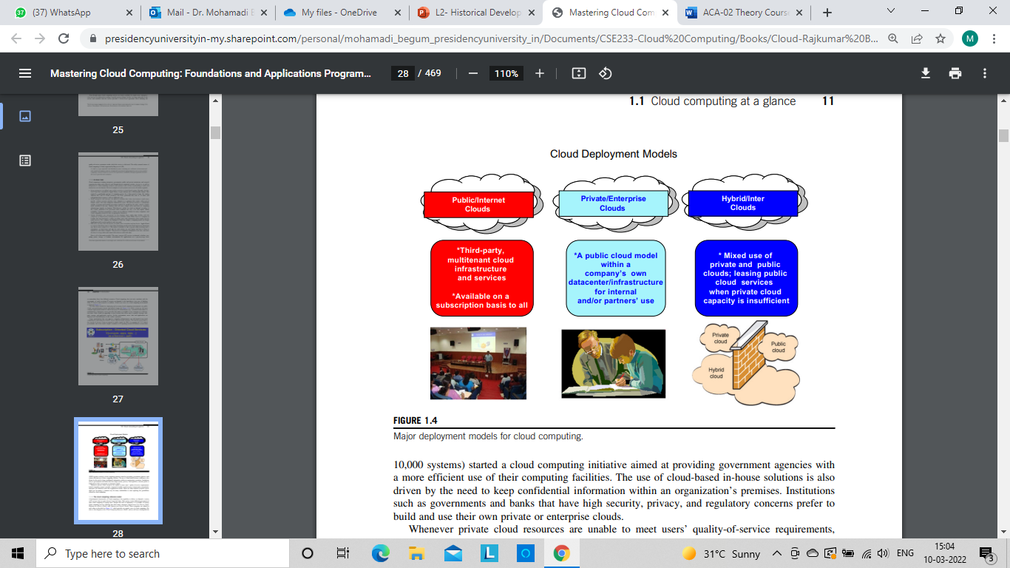
Major deployment models for cloud computing

Slide 64
Characteristics and benefits
No up-front commitments
On-demand access
Nice pricing
Simplified application acceleration and scalability
Efficient resource allocation
Energy efficiency
Seamless creation and use of third-party services

Slide 65
Cloud computing - challenges
Technical
Security
Legal

Slide 66
Building Cloud Environments

Slide 67
Overview
Application development
Infrastructure and system development
Computing platforms and technologies

Slide 68
Application development

Slide 69
What sort of applications benefit from cloud?
Dynamically scale on demand
Classes of applications
Web applications
Performance depends on workload generated by varying user demand
Rich, complex and interactive

Slide 70
What sort of applications benefit from cloud?
2. Resource-intensive applications
Data-intensive or compute-intensive applications
Resources are required to complete execution in a reasonable timeframe
But not required for a long duration
Not interactive, only batch processing
e.g. scientific applications

Slide 71
On-demand and dynamic scaling solution
How?
(a) providing methods for renting compute power, storage, and networking
(b) offering runtime environments designed for scalability and dynamic sizing
(c) providing application services that mimic the behavior of desktop applications but that are completely hosted and managed on the provider side
Service orientation
allows a simple and seamless integration into existing systems
Developers access such services via simple Web interfaces

Slide 72
Infrastructure and system Development

Slide 73
Core technologies enabling the provisioning of cloud services
Distributed computing
Virtualization
Service orientation
Web 2.0

Slide 74
Distributed Systems
Extreme dynamism of cloud systems
New nodes and services are provisioned on demand
Infrastructure-as-a-Service solutions
Provide the capabilities to add and remove resources
Platform-as-a-Service solutions
embed into their core offering algorithms and rules that control the provisioning process and the lease of resources
Integration between cloud resources and existing system deployment ???

Slide 75
Web 2.0
Constitute the interface through which cloud computing services are delivered, managed, and provisioned
Service orientation is the underlying paradigm
Cloud - XaaS—Everything-as-a-Service

Slide 76
Virtualization
Core feature of the infrastructure used by cloud providers
Virtualization concept is > 40 years old
but cloud computing introduces new challenges, especially in the management of virtual environments

Slide 77
Computing platforms and technologies

Slide 78
How to develop cloud applications?
Leverage
Platforms
Technologies
Frameworks
Amazon web services (AWS)
Google AppEngine
Microsoft Azure
Hadoop
Force.com and Salesforce.com
Manjrasoft Aneka

Slide 79
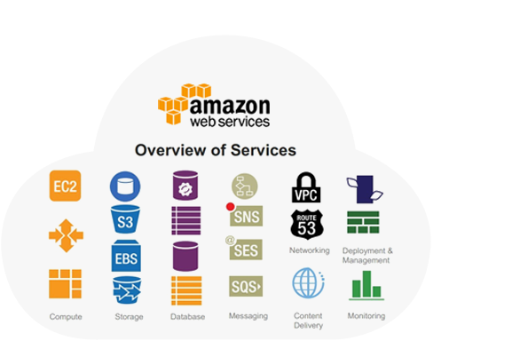
Amazon web services (AWS)
IaaS
Platform that offers flexible, reliable, scalable, easy-to-use and, cost-effective cloud computing solutions
compute and storage-on-demand services
Elastic Compute Cloud (EC2) and Simple Storage Service (S3)

Slide 80
Amazon web services (AWS)
Elastic Compute Cloud (EC2)
Customizable virtual hardware
EC2 instances are deployed either by using
AWS console, which is a comprehensive Web portal for accessing AWS services
Web services API available for several programming languages
Simple Storage Service (S3)
Delivers persistent storage on demand
S3 is organized into buckets; these are containers of objects that are stored in binary form and can be enriched with attributes
Users can store objects of any size, from simple files to entire disk images, and have them accessible from everywhere

Slide 81
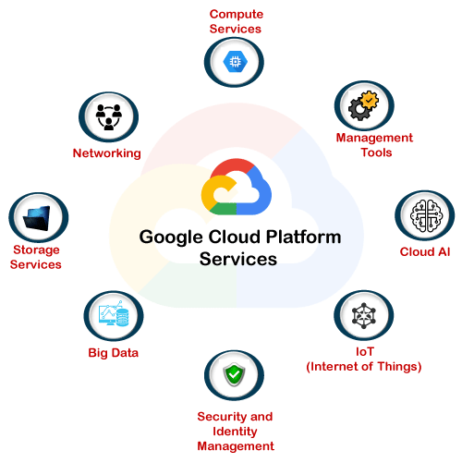
Google App Engine (GAE)
PaaS
Build highly scalable applications on a fully managed serverless platform
Large computing infrastructure of Google to dynamically scale

Slide 82
Google AppEngine
Services include in-memory caching, scalable data store, job queues, messaging, and cron tasks
GAE requires that applications be written in Java or Python, store data in Google Bigtable and use the Google query language.
IaaS similar to EC2
Google provides GAE free up to a certain amount of use for the following resources:
processor storage
API calls
concurrent requests

Slide 83
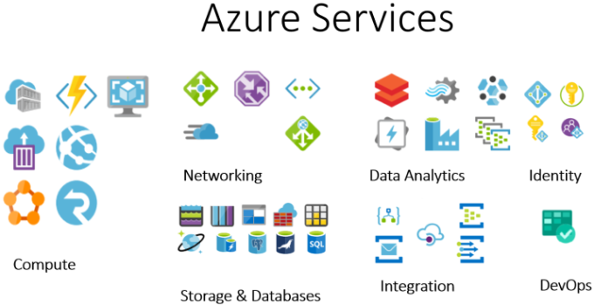
Microsoft Azure
Provides a scalable runtime environment for Web applications and distributed applications

Slide 84
Microsoft Azure
Web role is designed to host a Web application
Worker role is a more generic container of applications and can be used to perform workload processing
Virtual machine role provides a virtual environment in which the computing stack can be fully customized, including the operating systems
Applications in Azure are organized around the concept of roles, which identify a distribution unit for applications and embody the application’s logic
Three types of role: Web role, worker role, and virtual machine role

Slide 85
Hadoop
Apache Hadoop is an open-source framework
that is suited for processing large data sets on commodity hardware
Hadoop is an integral part of the Yahoo! cloud infrastructure
Hadoop is an implementation of Map Reduce, an application programming model developed by Google
which provides two fundamental operations for data processing: map and reduce
Map - transforms and synthesizes the input data provided by the user
Reduce - aggregates the output obtained by the map operations
Hadoop provides the runtime environment
Developers need only provide the input data and specify the map and reduce functions that need to be executed

Slide 86
Force.com and Salesforce.com
Force.com is a cloud computing platform for developing social enterprise applications
complete set of components supporting all the activities of an enterprise
provides complete support for developing applications - design of the data layout to the definition of business rules and workflows and the definition of the user interface
The platform is the basis for SalesForce.com, a Software-as-a-Service solution for customer relationship management

Slide 87
Manjrasoft Aneka
Cloud application platform for rapid creation of scalable applications
Supports a collection of programming abstractions for developing applications and a distributed runtime environment that can be deployed on heterogeneous hardware (clusters, networked desktop computers, and cloud resources)
Applications are executed on the distributed service-oriented runtime environment, which can dynamically integrate additional resource on demand
Services manage most of the activities happening at runtime: scheduling, execution, accounting, billing, storage, and quality of service

Slide 88
Review Questions
Which are the technologies on which cloud computing relies?​
Define cloud computing and identify its core features. ​
Briefly summarize the Cloud Computing Reference Model.
​How is cloud development different from traditional software development?​

